Slide 1
Networking and the Web

Slide 2
Introduction
In this presentation, we'll look at networking, the Internet and the World Wide Web.

Slide 3
What is a Network?
A network connects computers and devices to share data and resources. Types of networks include:
Local Area Network (LAN): links devices in close proximity
Wide Area Network (WAN): connects LANs across greater distances
Common connection types: Ethernet, WiFi, cellular, satellite

Slide 4
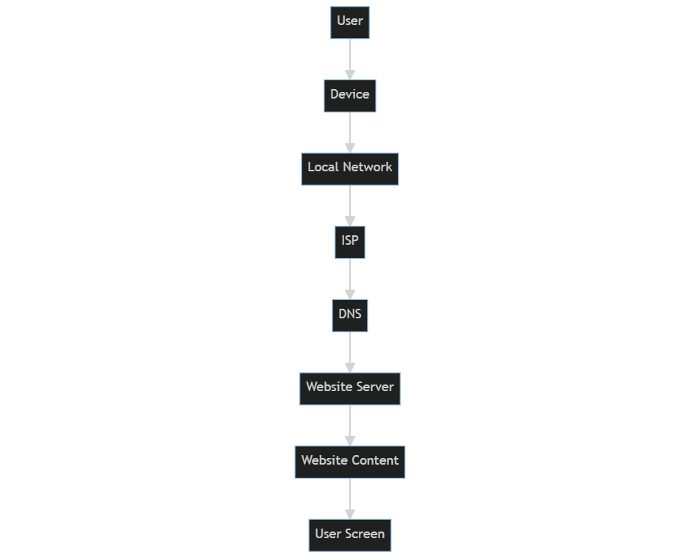
How the Internet Works
Internet Service Providers (ISPs) connect users to backbone of high-speed fiber optic cables
Packets of data travel through a series routers to reach destination
A Domain Name Server (DNS) translates human-friendly names to IP addresses
A Web Server servers the requested content

Slide 5
The World Wide Web
System of internet servers that support web pages
Each page has unique URL (Uniform Resource Locator) to locate it
Hypertext links connect pages together
Web browsers request and display pages

Slide 6
Web Applications
Interactive apps accessed through web browser
Run on web servers and built using languages like HTML, CSS, JavaScript
Updated dynamically; feel like desktop apps
Examples: webmail, social media, webshops, etc

Slide 7
Cloud Computing
On-demand services provided over the internet
Scalable, self-service access to virtualized resources
Types: IaaS, PaaS, SaaS
Benefits: agility, lower costs, global access
Examples: AWS, Azure, Google Cloud

Slide 8
Review: Key terminology
IP address, DNS, TCP/IP, bandwidth, LAN, WAN
Packets, routing, DNS, HTTP, HTTPS
URL, links, web page, web server, web browser
Cloud types: IaaS, PaaS, SaaS

Slide 9
Thank you!
Q & A

